Slide 1
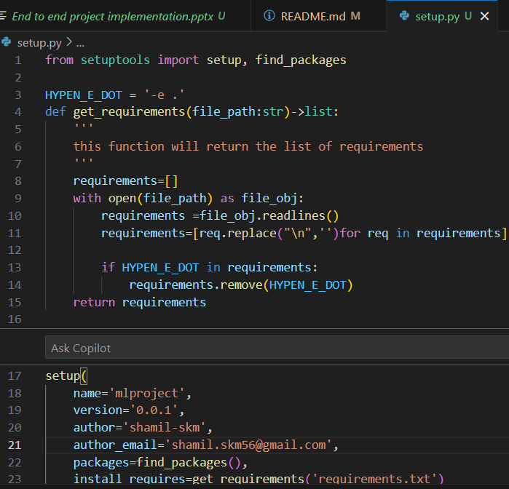
Create virtual environment
conda create –p python==3.12 –y
Create README.md
Git init
Create respiratory(follow the instructions in github)
Create gitignore
Create setup.py & requirements.txt

